Slide 1

CAPSTONE PROJECT
Play Store App Review Analysis
Presented By:
K . Kalaiselvi - Karpaga Vinayaga College of Engineering & Technology - B.Tech. Biotechnology

Slide 2
OUTLINE
Problem Statement
Proposed System/Solution
System Development Approach
Algorithm & Deployment
Result
Conclusion
Future Scope
References

Slide 3
Problem Statement
The Play Store apps data has enormous potential to drive app-making businesses to success. Actionable insights can be drawn for developers to work on and capture the Android market. Each app (row) has values for category, rating, size, and more. Another dataset contains customer reviews of the android apps. Explore and analyse the data to discover key factors responsible for app engagement and success.

Slide 4
Proposed Solution
The proposed solution involves the systematic approach to explore and analyze the Play Store apps data and customer reviews dataset to uncover key factors driving app engagement and success.
It starts with the data gathering from the dataset given and will be preprocessed by removing duplicates, standardizing formats and resolving inconsistencies.EDA is conducted to know the distributions of variables like app category ,etc. Then it can be visualised using Histograms, bar charts and scatter plots . Using Statistical methods and Machine learning methods we can correlate the different features and app success metrics. Finally the sentiment analysis is made by classifying the reviews as positive, negative or neutral and analysing the trends over the time.

Slide 5
System Approach
1. Data Collection and Integration: Gather data from the Play Store apps dataset and the customer reviews dataset. Ensure compatibility and consistency between the datasets for seamless integration and analysis.
2. Data Preprocessing: Cleanse the datasets by handling missing values, removing duplicates, standardizing formats, and resolving inconsistencies. This step ensures that the data is ready for analysis.
3. Exploratory Data Analysis (EDA): Conduct EDA to gain insights into the characteristics and distributions of variables such as app category, ratings, size, and customer reviews. Visualizations such as histograms, bar charts, and scatter plots can be used to identify patterns and trends.
4. Feature Engineering: Extract relevant features from the datasets that could influence app engagement and success. This may include creating new variables, aggregating data, or transforming existing features to make them more informative for analysis.
5. Statistical Analysis and Modeling: Apply statistical methods and machine learning algorithms to identify correlations between different features and app success metrics such as downloads, ratings, and user engagement. Regression analysis, classification models, and clustering techniques can be utilized to uncover relationships and patterns in the data.
6. Sentiment Analysis: Perform sentiment analysis on customer reviews to gauge user sentiment towards the apps. This involves classifying reviews as positive, negative, or neutral, and analyzing trends in sentiment over time or across different app categories.
7. Feature Importance and Insights Generation: Use feature importance techniques to prioritize factors that have the most significant impact on app engagement and success. Generate actionable insights and recommendations for developers based on the findings from the analysis.
8. Validation and Iteration: Validate the findings through rigorous testing and validation procedures. Iterate on the analysis as needed to refine and improve the accuracy and reliability of the insights generated.
9. Visualization: Present the findings in a clear and concise manner through reports, dashboards, or interactive visualizations.

Slide 6

Algorithm & Deployment
Algorithm:
Deployment:
import pandas as p
import numpy as n
import matplotlib.pyplot as m
import seaborn as s
data=p.read_csv("C:\Program Files\Training
_Data_Google_Play_reviews_6000.csv")
data.head(50)
data.columns
data.tail(50)
data.describe()
s.scatterplot(x=data["score"],y=data
["thumbsUpCount”],data=data)
m.title('Scatterplot')
m.xlabel('score')
m.ylabel('thumbsUpCount')
m.show()
s.boxplot(x='score',y='thumbsUpCount',data=data)
m.title('Boxplot')
m.xlabel('score')
m.ylabel('thumbsUpCount')
m.show()
s.histplot(data["score"],bins=30,kde=True)
m.title('Histogram')
m.xlabel('score')
m.ylabel('thumbsUpCount')
m.show()
data["score"].value_counts().plot(kind='bar')
m.title('Bardiagram')
m.xlabel('score')
m.ylabel('thumbsUpCount')
m.show()
For deploying the solution for the problem statement of analyzing Play Store apps data and customer reviews to discover key factors for app engagement and success, the following steps can be followed:
1. Infrastructure Setup: Establish the necessary infrastructure for hosting the application, such as cloud servers (e.g., AWS, Google Cloud Platform, Microsoft Azure) or on-premises servers. Ensure that the infrastructure meets the requirements for data storage, processing, and scalability.
2. Application Development: Develop the application for data analysis and visualization. This may involve building a web-based dashboard or a standalone application using frameworks like Flask, Django, or Streamlit. Ensure that the application provides an intuitive user interface for interacting with the data and accessing insights.
3. Data Pipeline Setup: Implement a data pipeline for ingesting, processing, and storing the Play Store apps data and customer reviews.
4. Model Deployment: Deploy the machine learning models or statistical analysis algorithms developed during the solution phase. Use frameworks like TensorFlow Serving, Flask, or FastAPI to expose the models as RESTful APIs or microservices for real-time inference.
5. Database Configuration: Set up a database to store the preprocessed data, analysis results, and user interactions with the application. Choose a database solution based on the requirements for scalability, performance, and data structure.
6. Security Measures: Implement security measures to protect sensitive data and ensure compliance with privacy regulations (e.g., GDPR, HIPAA). Use encryption, access controls, and secure authentication mechanisms to safeguard the application and its data.
7. Monitoring and Logging: Set up monitoring and logging mechanisms to track application performance, detect anomalies, and troubleshoot issues in real-time. Use tools like Prometheus, Grafana, ELK Stack, or AWS CloudWatch for monitoring and logging.
8. Continuous Integration/Continuous Deployment (CI/CD): Implement CI/CD pipelines to automate the deployment process and ensure rapid and reliable updates to the application. Use tools like Jenkins, GitLab CI/CD, or AWS CodePipeline for CI/CD automation.
9. Testing and Quality Assurance: Conduct thorough testing of the application to ensure functionality, reliability, and performance. Perform unit tests, integration tests, and end-to-end tests to validate the application's behavior under different scenarios.
10. User Training and Support: Provide training and support resources for users to effectively utilize the application and interpret the insights generated. Offer documentation, tutorials, and user guides to assist users in navigating the application and understanding its capabilities.
By following these deployment steps, the solution for analyzing Play Store apps data and customer reviews can be effectively deployed and utilized to derive actionable insights for app engagement and success.

Slide 7
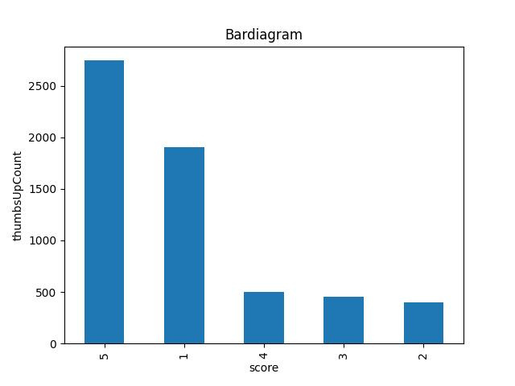
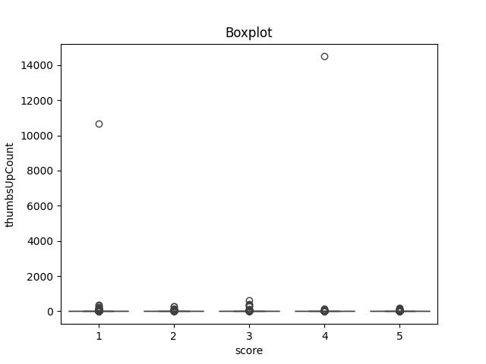
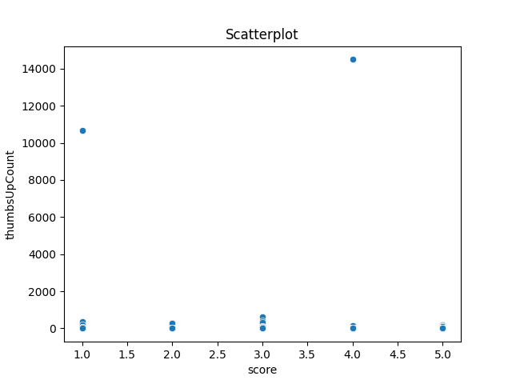
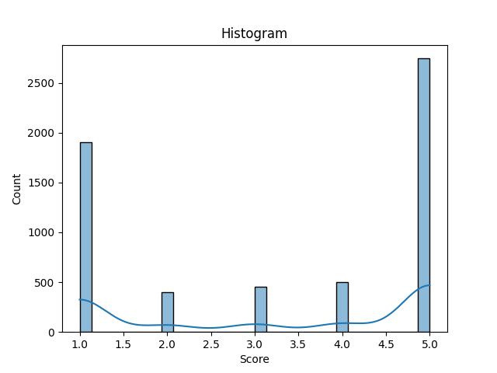
Result

Slide 8
Conclusion
Through a systematic approach encompassing data preprocessing, exploratory analysis, feature engineering, statistical modeling, and deployment of machine learning models, developers can uncover key determinants influencing app performance. Developers can make informed decisions regarding app development strategies, feature prioritization, user experience enhancements, and marketing initiatives. Understanding user sentiments, identifying popular app categories, optimizing app size, and improving app ratings are among the critical aspects that contribute to app success.the deployment of an intuitive and scalable application for analyzing app data facilitates continuous monitoring, iteration, and adaptation to changing market dynamics. Maximize their chances of capturing the Android market and driving sustainable app engagement and growth.the analysis of Play Store apps data and customer reviews serves as a powerful tool for app makers to navigate the competitive landscape, innovate effectively, and ultimately achieve success in the dynamic world of mobile applications.

Slide 9
Future scope
Advanced Analytics Techniques: Integration of advanced analytics techniques such as natural language processing (NLP), deep learning, and predictive modeling to extract deeper insights from customer reviews, including sentiment analysis, topic modeling, and trend prediction.
Personalization and Recommendation Systems: Development of personalized recommendation systems based on user preferences, behavior, and feedback, enhancing user engagement and retention by offering tailored app suggestions.
Real-time Monitoring and Feedback: Implementation of real-time monitoring systems to track app performance metrics, user interactions, and market trends, enabling developers to respond promptly to emerging issues and opportunities.
Cross-platform Analysis: Expansion of analysis to include data from other app distribution platforms (e.g., Apple App Store, Google Play Store) and comparison of performance metrics across platforms to identify cross-platform trends and insights.
User Behavior Analysis: In-depth analysis of user behavior patterns, including app usage patterns, user journeys, and churn prediction, to understand user preferences and optimize app experiences accordingly.
Integration with Developer Tools: Integration of app analytics and insights directly into developer tools and platforms (e.g., Android Studio, Firebase), empowering developers with actionable insights during the app development and optimization process.
Ethical Considerations and Privacy: Exploration of ethical considerations and privacy implications associated with app data analysis, ensuring responsible data handling practices and compliance with regulations such as GDPR and CCPA.
Collaborative Research and Open Data Initiatives: Collaboration between academia, industry, and open data initiatives to share datasets, methodologies, and insights, fostering innovation and collective understanding of app engagement dynamics.
Emerging Technologies: Exploration of emerging technologies such as augmented reality (AR), virtual reality (VR), and blockchain for novel applications in app engagement analysis and optimization.
Continuous Learning and Adaptation: Establishment of frameworks for continuous learning and adaptation, enabling developers to iteratively improve app engagement strategies based on ongoing analysis, experimentation, and feedback.

Slide 10
References
https://www.naanmudhalvan.tn.gov.in/https:/skillsbuild.org/https:/www.canva.com/https:/www.google.com/https:/chat.openai.com/https:/www.python.org/

Slide 11
THANK YOU

